Slide 1
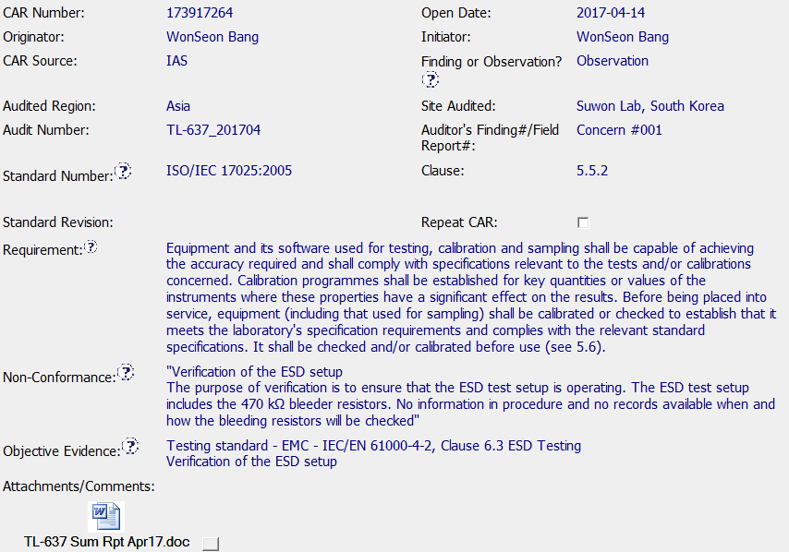
CAR 173917264 OBSERVATION

Slide 2

CAR 173917264 OBSERVATION
Explain how/If the analysis supports the root cause statement. (Michelle)
Analysis light - they have gone through several “Why’s”. If this was a finding, we would expect them to do a deeper dive into the 5 (or more) why’s.
2. Explain why/If the evidence in the milestones was sufficient to confirm that the nonconformity was eliminated. (Jeff)
It was fully supported. Since this is an “OBSERVATION” CAR, the intent of the NC was to correct a situation where Test Setup did not include testing for bleeding resistors. The robustness of the Analysis wasn’t the same as if this had been classified as a FINDING. Since daily checklists for bleeding resistors was added to the process, the procedure was updated to include the requirement, staff was notified, and training was put in place, I feel the intent of this OBSERVATION was fully met.

